Slide 1



Rust on Raspberry PI Zero
User Guide

Slide 2






Software Requirements:
1) Windows 10 with last updates (2004)
2) PiDebug V0.0.1 Beta
3) VirtualBox 6.12
4)Ubuntu / Ubuntu Mate 18.0.4.5 LTS
5)Rust (Last version)
6)Raspberry PI Image Flasher

Slide 3
First Step (Prepare SSH)
Flash SD-card via RPI Writter
Open PiDebug and Press Edit Kernel Button.
Select a boot volume and press OK
Wait while text Patched ? : will changed and become olive green.

Slide 4
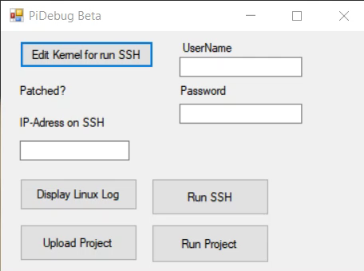

Slide 5
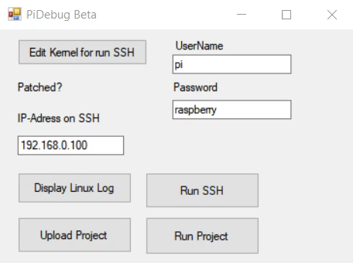
Next Install SD card to RPI and connect in to Router.
After it enter all creditals to PiDebug and check connection via getting Linux Log. After it connect via SSH.

Slide 6
Install&Configure Samba
Install Samba by . sudo apt-get install samba samba-common-bin
Create folder by : sudo mkdir -m 1777 /share
Open Samba config by : sudo nano /etc/samba/smb.conf
Add to bottom of file this config :
[share]
Comment = Pi shared folder
Path = /share
Browseable = yes
Writeable = Yes
only guest = no
create mask = 0777
directory mask = 0777
Reboot RPI after it

Slide 7
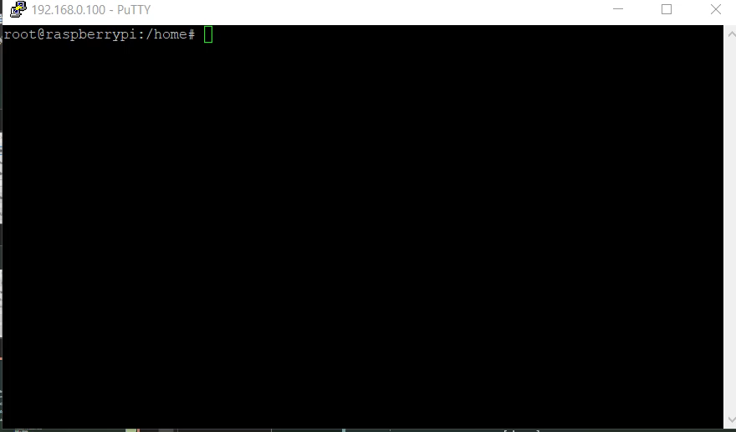

Slide 8
Open Network Option in Explorer and try access to folder that Raspberry is sharing.

Slide 9
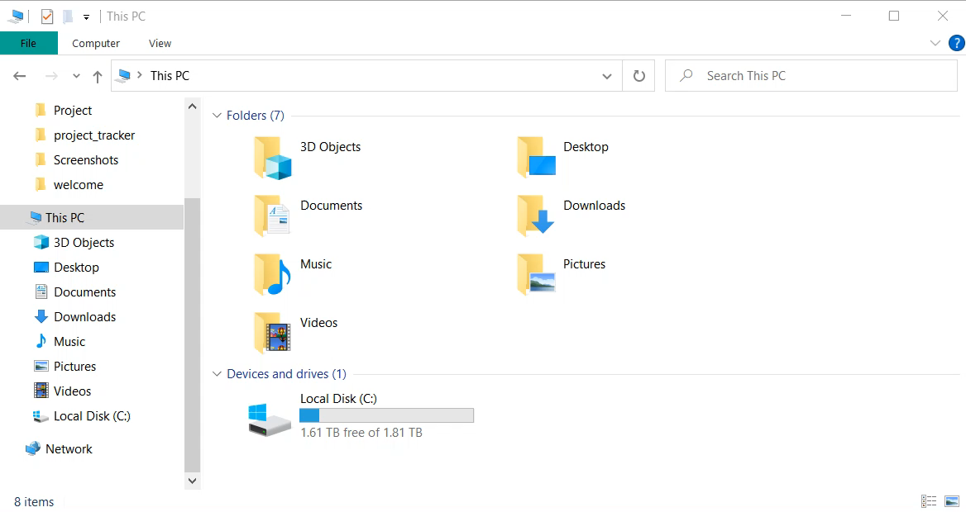

Slide 10
Create Virtual Machine and install Ubuntu.
Make : sudo apt update
Install VirtualBox Additions
Install rustup using : curl https://sh.rustup.rs -sSf | sh
Set default toolchain by : rustup default stable
Install all dependencies by : sudo apt-get install gcc-arm-linux-gnueabihf libc6-armhf-cross libc6-dev-armhf-cross
Set another toolchain by : rustup target add arm-unknown-linux-gnueabihf
In user folder create new folder .cargo
Step into it
Create file config.toml
Open it with nano by : sudo nano config.toml
File content :
[target.arm-unknown-linux-gnueabihf]
linker = "$HOME/rpi_tools/arm-bcm2708/arm-linux-gnueabihf/bin/arm-linux-gnueabihf-gcc"
Set one more toolchain by : rustup target add arm-unknown-linux-gnueabi
Get c++ linkers by : git clone https://github.com/raspberrypi/tools $HOME/rpi_tools
set it by : RUSTFLAGS="-C linker=$HOME/rpi_tools/arm-bcm2708/arm-rpi-4.9.3-linux-gnueabihf/bin/arm-linux-gnueabihf-gcc" cargo build --target arm-unknown-linux-gnueabihf --tests
Finally build project using: cargo build --target=arm-unknown-linux-gnueabihf

Slide 11
